Slide 1
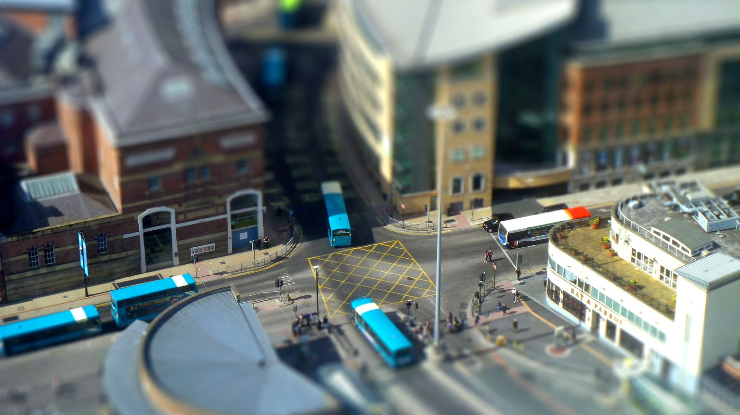
Institute for Transport Studies
FACULTY OF ENVIRONMENT
Routing
Getting from A to B the thoughtful way
Dr Malcolm Morgan
Research Fellow in Transport and Spatial Analysis
Transport Data Science
19th March 2019

Slide 2
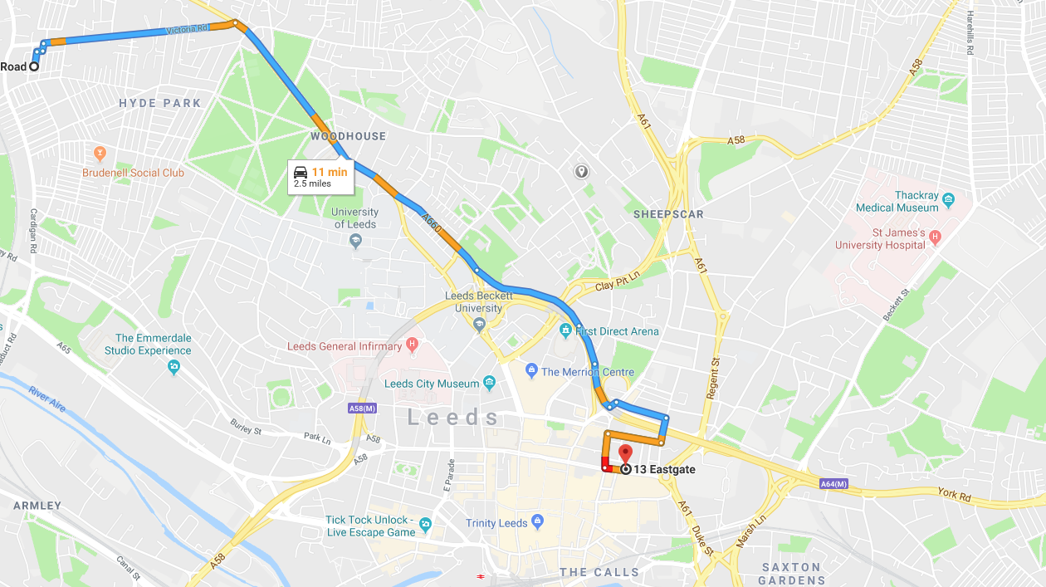
What is routing
Finding the “shortest” path between two locations
Distance
Time
Other factor

Slide 3
Content
Graph Theory
Shortest Path Routing
Practical Routing in R
Going beyond A to B routing

Slide 4
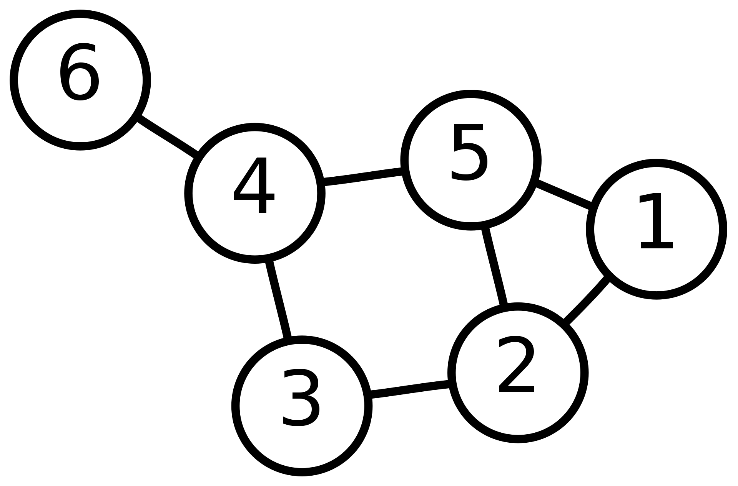
Graph Theory
Branch of mathematics about graphs (networks)
Vertex (Node)
Edge (Link)

Slide 5
Basic Properties of a Graph
Directed or Undirected
Do edges have a direction
Weighted or Unweighted
Are all edges equal or do they have a value
Complex or Simple
Allow loops
Allow multiple edges
Contracted or Uncontracted
Are there straight lines (vertices with 2 edges)
Connected or Unconnected
All parts of the graph connected

Slide 6
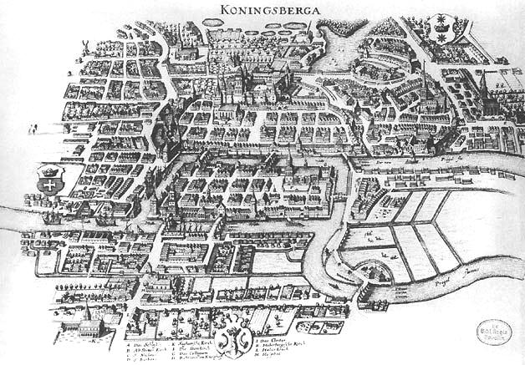
The Königsberg Bridge problem
Path though the city crossing each bridge once
Solved by Euler in 1736
Foundation of graph theory

Slide 7
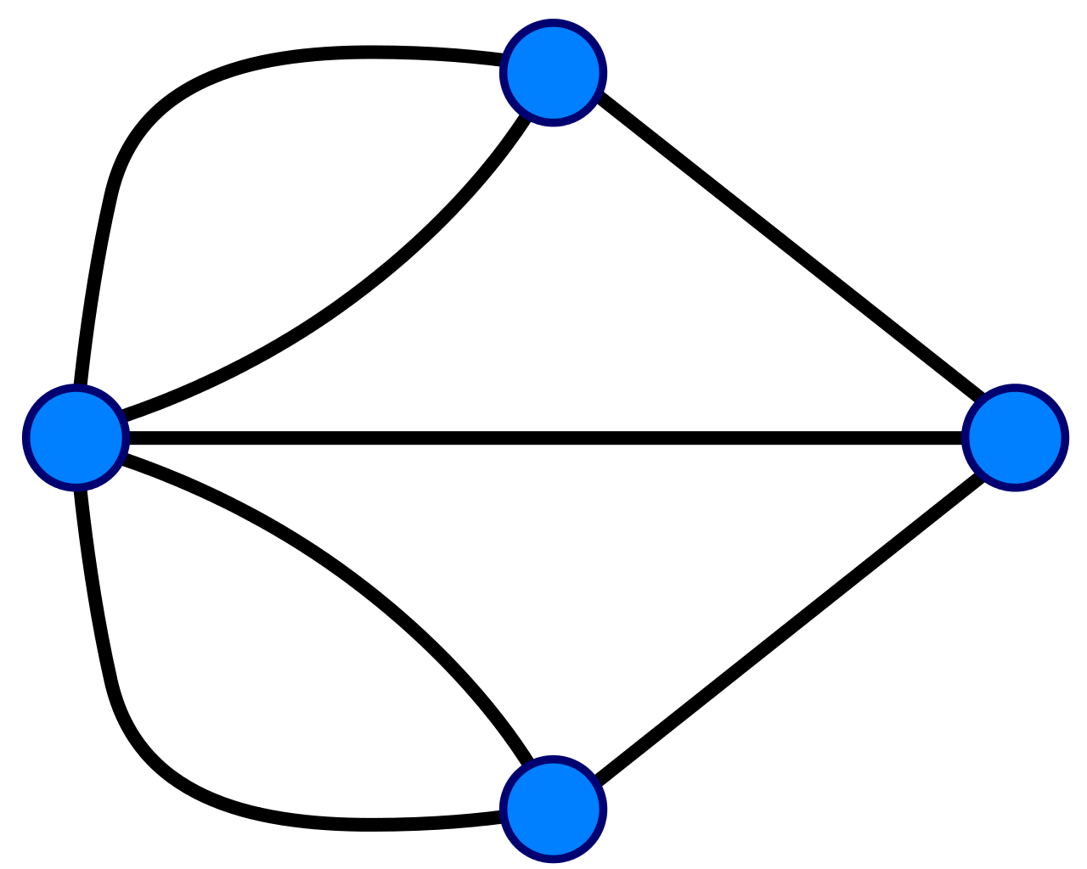
The Königsberg Bridge problem
3
Degree: Number of edges connected to a vertex
Strength: Weighted number of edges
Euler Observed:
Vertices must have even degree except the start and end
So there is no solution
5
3
3

Slide 8
The Königsberg Bridge problem
Bonus Problem
Where would you add a bridge such that you could start at the Red vertex and finish at the Yellow vertex
What would the path be?

Slide 9
Shortest Path
Dijkstra Algorithm
Visits each unvisited node counting cumulative distance
Prioritised by distance, thus excludes options longer than current shortest route
O(|V|²) unprioritized
O(|E| + |V|log|V|) when using a priority heap
Source: https://en.wikipedia.org/wiki/File:Dijkstra_Animation.gif

Slide 10
Shortest Path
A* Search Algorithm
Widley used and faster than Dijkstra Algorithm
Prioritises the next path by both:
The total distance so far
A heuristic to estimate the remaining distance (e.g. straight line distance)
ALT
A* search, landmarks, and triangle inequality
Modified for road networks
Source: https://commons.wikimedia.org/wiki/File:Astar_progress_animation.gif

Slide 11
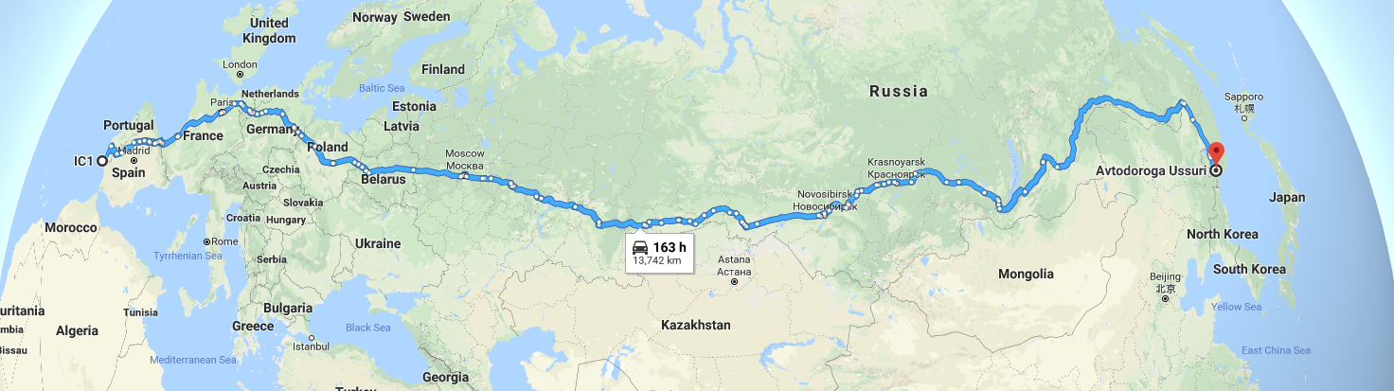
Shortest Path
Best algorithms now precompute parts of routes
Finding useful shortcuts
E.g. using motorways for long distance travel

Slide 12
Practical Routing In R
Packages to use routing services
Packages for inbuilt routing
Why not Google it?

Slide 13
Routing Services in R
Google Maps
googleway package https://cran.r-project.org/web/packages/googleway/
Open Source Routing Machine (OSRM)
osrmr package https://cran.r-project.org/web/packages/osrmr/
Open Route Service https://maps.openrouteservice.org
ORS Package https://giscience.github.io/openrouteservice-r/
Transport API
UK only but does public transport
Prototype package https://github.com/mem48/transportAPI
CycleStreets
Cycling only https://cran.r-project.org/web/packages/cyclestreets

Slide 14
Local Routing in R
OSRM (again)
Require separate setup of OSRM
dodgr https://cran.r-project.org/web/packages/dodgr
New package still in development
stplanr https://cran.r-project.org/web/packages/stplanr
Some basic routing functions based on igraph
igraph https://cran.r-project.org/web/packages/igraph
General graph analysis not specific to transport
OpenTripPlanner https://github.com/ITSLeeds/opentripplanner
Work in progress for multimodal planning
Requires separate setup of OTP
Gtfs-router https://github.com/ATFutures/gtfs-router
For integrating GTFS public transport timetables

Slide 15
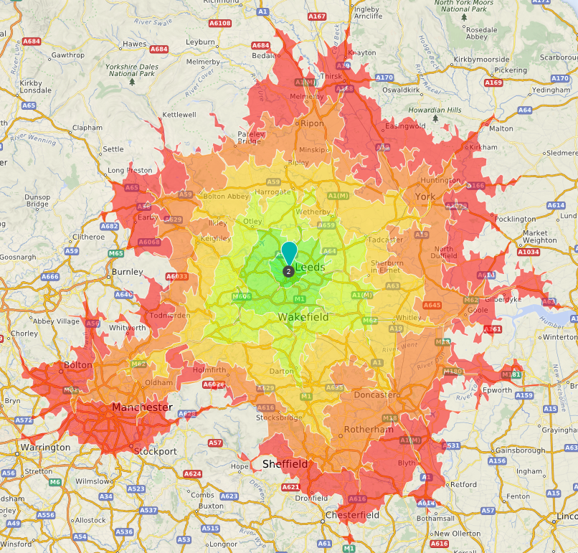
Isochrones
Open Route Service
Road modes only but no traffic
Google
Paid for but includes traffic
Open Trip Planner
public transport
Can do road modes (but results unreliable)

Slide 16
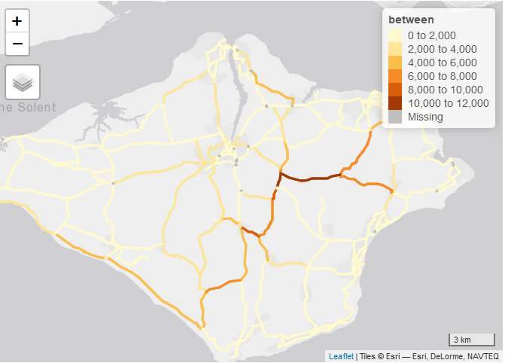
Network Analysis
igraph
Via dodgr
dodgr_to_igraph
Via stplanr (spatial lines network)
http://rpubs.com/edzer/6767
Slow with large networks
Consider contraction and simplifications

Slide 17
Practical
https://itsleeds.github.io/TDS/practicals/6-routing.html

Slide 18
References
Types of Graph: http://www.personal.kent.edu/~rmuhamma/GraphTheory/MyGraphTheory/defEx.htm

Slide 19
The Königsberg Bridge problem
3
Bonus Problem
Where would you add a bridge such that you could start at the Red vertex and finish at the Yellow vertex
What would the path be?
5
4
4

